Slide 1
Musical Instrument Digital Interface
Miguel Cuéllar, Martín Castañeda, Alejandro Angulo & Mario Alberto Gómez

Slide 2
What is MIDI?
MIDI, or also better known by its abbreviation of Musical Instrument Digital Interface is a technological standard that is used to describe a protocol, a digital interface and connectors that allow various electronic musical instruments, computers and other related devices to connect and communicate with each other.
In other words, it's how electronic devices, such as synthesizers, samplers and/or computers, that perform music production and control sound can be connected to each other via MIDI messages.

Slide 3
According to Experts
According to MIDI Manufacturers Association (MMA), "MIDI is an industry standard music technology protocol that connects products from many different companies including digital musical instruments, computers, tablets, and smartphones" (2019).

Slide 4
Why use MIDI?
The MIDI system carries event messages that specify musical notation, pitch, and speed signals that synchronize time between various devices. These messages are sent via a MIDI cable to other devices that control the generation of sounds. This data can also be recorded in a sequencer (like hardware or software) which allows you to edit the information and play it back later (Huber, 1991).
The advantages of using MIDI include its size because an entire song can be encoded in a few hundred lines, for example in a few kilobytes, and the easy manipulation, modification and selection of instruments.

Slide 5
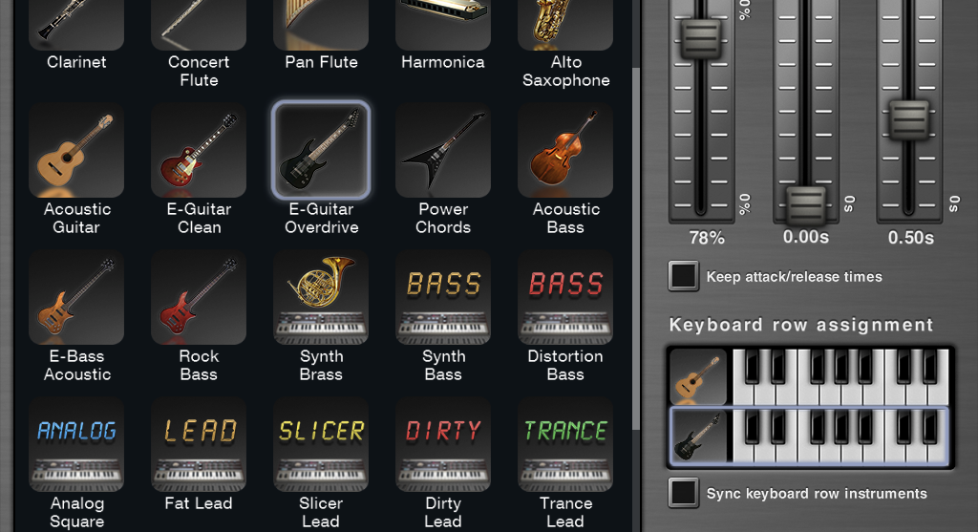
MIDI Instruments
MIDI instruments are instruments created by sofwer, digital sounds, which simulate other real instruments. the difference between the midi and a real instrument is that the midi is completely dijital, the real instruments are completely analogous, however you can mix the two through the controllers. since they are instruments such as pianos, trumpet guitars, saxophone, almost all instruments have a version as midi controller. also be mixed in the guitars for example by means of pedals, which can be programmed from the computer with sounds or midi effects.

Slide 6
MIDI Controlers
MIDI controllers are in charge of managing the dijital signal and controlling it in a simpler way, not directly from the computer but from a piano, a guitar or any instrument with a midi controller. The most important and most used controller is the piano and the pads, the others exist but they are more recent and a musician is facilitated more in a piano.

Slide 7
Midi messages & A brief history of midi
By: Miguel Cuéllar Gómez

Slide 8
Messages in MIDI
Messages in MIDI are some of the most important parts of MIDI, since they are what takes the MIDI digital protocols to a practical way.
A message in MIDI is a performance event directed to the action needed to do such as a change in the sound, its pitch loudness etc… It may involve as well events that aren’t related to sound and internal actions involving the system itself and not with external performances.
A possible message is: “Note On”, which marks the beggining of the note, “Velocity” which defines the loudness of the note in relation with others.
These messages aren´t only about the sound, since there are extensions for the messages that include MIDI machine control and MIDI show control, which can control the stage´s lights, smoke machines and other effects.

Slide 9
Types of Messages
Note on/off: Orders the start of the note.
Pitch Bend: Orders the ‘sliding’ of notes up and down, as with the pitch bend wheels.
Continuous Controller: Modules the pitches of the notes, as with the violin vibrato sound.
Program Change: Changes the instrument sound played.
Velocity: Changes the loudness of the note played.
Bank Select: Along with the program change message it changes the instrument sound played.

Slide 10
Early Synthesizers

Slide 11
A Brief History of MIDI
•The first MIDI standard was released in 1983 by Dave Smith in California to supply the needs of music producers that required a standard protocol in their digital musical equipment.
•At the time of the MIDI’s standard first release, it only covered the standardization of musical reproduction timing in digital equipment.
•Throughout the 90’s there were some digital keyboard releases that used MIDI standards, that enhanced its quality and added more features and standards.
•MIDI has eventually evolved to what it’s today and has been improved in its functions and enhanced in its abilities. Despite these things, MIDI still has some general flaws that include the timing of recording and playback and delays in its generation of sound.
•To solve these problems an alternative called the Zeta Instrument Processor Interface was created in the 90’s, but it never saw acomercial release. This system has better timing features, and has been proposed as a base and inspirations for better MIDI control systems.

Slide 12
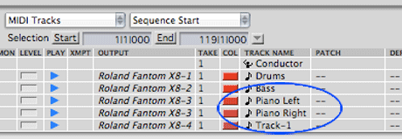
Different sounds and channels
•If they are in different channels they can be more than 16 different sounds of a same instrument or also 16 sounds of different intruments, in that way it can be a combination of sounds in different channels.

Slide 13
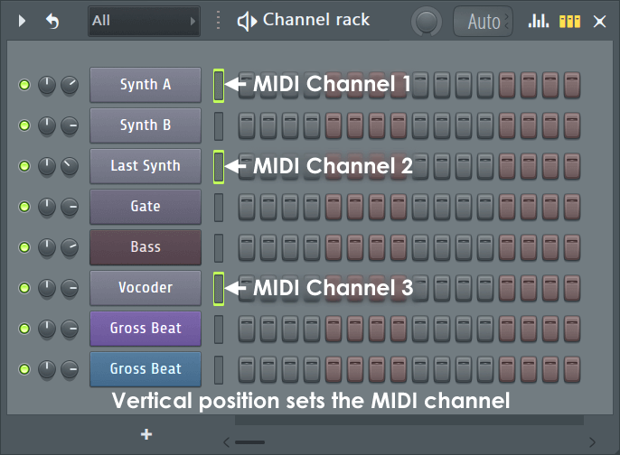
Midi channels
• MIDI channels are the number of channels or streams of data that can be sent down one set of MIDI cables to one MIDI instrument.

Slide 14
Sources
https://www.musicradar.com/news/tech/30-years-of-midi-a-brief-history-568009
https://www.midi.org/articles/a-brief-history-of-midi
https://www.perfectcircuit.com/signal/history-of-midi
https://www.instructables.com/id/What-is-MIDI/
https://www.midi.org/

