Slide 1
Shark tank
Alejandro Angulo

Slide 2
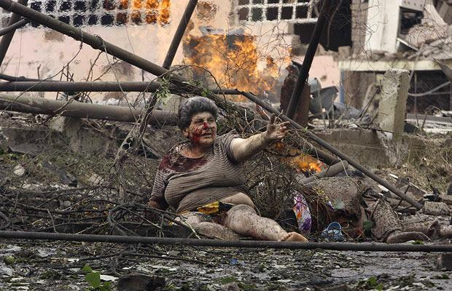
concept
My concept is the violence and the war in the world, in my project I will show and explain this concept by making a figure of a foot with soldier toys and then that foot will step into a mine, that will represent the violence of the world because soldiers represent the way country governments sometimes try to solve their problems, sending innocent people to fight the fights of the problems of the governments. The mine represent how the soldiers and in general people are affected by the violence and the war.

Slide 3
References
Edward Kienholz
Edward Kienholz is an artist that make art with not the normal objects that all artist make, he is dedicated to make art with objects in a bad state or damage objects, with this type of art he tries to show the corruption and violence in the world.
This is related to my concept because what Edward tries to show is the corruption and how this is one of the most common causes of internal or external conflicts in the world that finish causing the world were soldiers and innocent people are unfairly affected by the violence.

Slide 4
Edward Kienholz art example
This sculpture of Edward Kienholz is related to my sketch because in both there is represent how the soldiers are risking there lives in war in an enviroment of violence and war relating also with my concept.

Slide 5
Reference 2
Bansky is an artist that is dedicated to do art in the graffitis uin the Street using dark humour and using the political problems for there art pieces.

Slide 6
Sketch

Slide 7
Materials
Soldiers figures
Red Paint
Boxes
Paper roll
Gold Paint
Soil

Slide 8
Curatorial approach
This Project i will make it in the art class while i make its structure of the foot and the painting, then when i put the soil in the sculpture i will go to the soccer fields for simulating the war enviroment.

