Slide 1
Shark Tank
By alejandro angulo

Slide 2
My soccer passion
Soccer call my attention since very young, always I try to watch the more matches possible in the way to know more about this sport and enjoy the feelings it caused being part of it. Go to school after a day of match and have a conversation with your friends of what happened the night before in the game, is a feeling of happiness. Go to the stadium and suffer all the match for your favorite team causes you panic, suspense, enjoyment and happiness. For this I make this drawing for represent all my passion for soccer and have an object that can transmits all that feelings in one.

Slide 3
Transformation
From this
To this

Slide 4
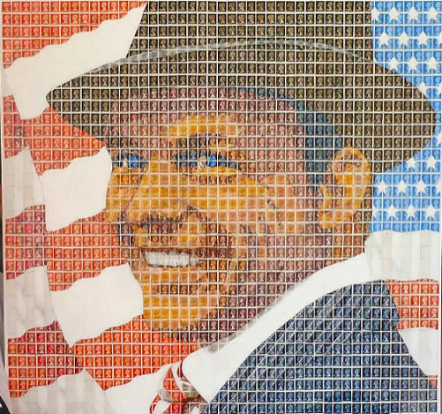
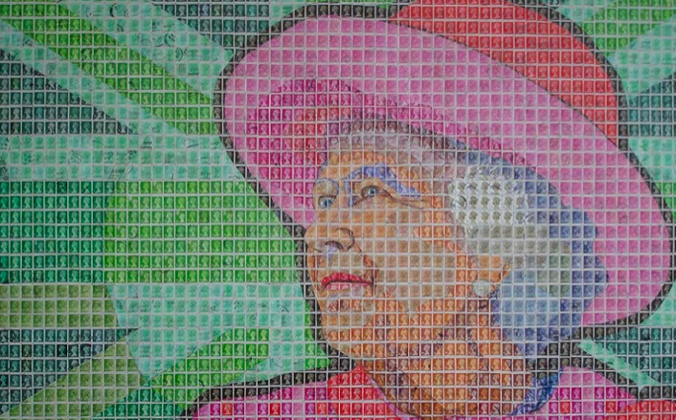
My own transformation
Examples of pete manson art:
In order to this project in a more personal approach i will use the idea of the screws as a base, anyway my personal idea is to use some photos of memories i have with soccer as if they were the screws, so the images will be the ones that will form the initial drawing of Messi i have and at the same time they will show some moments i have lived by only seeing the images. With this i want to show the importance and influence soccer has to me.
Reference of this technique: Pete Manson is an artist dedicated to do mosaics with different materials in order to create a portrait of different characters, some of his favorite materials are recycled stamps of different colors that have also different designs.

Slide 5
References
1st reference Andrew Myers: Andrew Myers is an artist that is dedicated to do art with screws, he made some type of drawings with this material, he tells that “Screws allow me to give a sense of depth” This can help me in my project for have a base of what techniques use and how is the proper use of the screws.
https://www.bioguia.com/hogar/arte-con-tornillos-andrew-myers_29268962.html
2nd reference Wilmer guedez: Wilmer guedez is an artist that is dedicated to the plastic art, in witch in his works he show us the importance of the color, he tells that the color is the feeling of the art, the type of color selected can change the ambient and feeling of the work. This can help me in my work for knowing witch color use for showing my real intention I want to transmit.
https://steemit.com/spanish/@wilmerguedez/la-importancia-del-color-en-las-artes

Slide 6
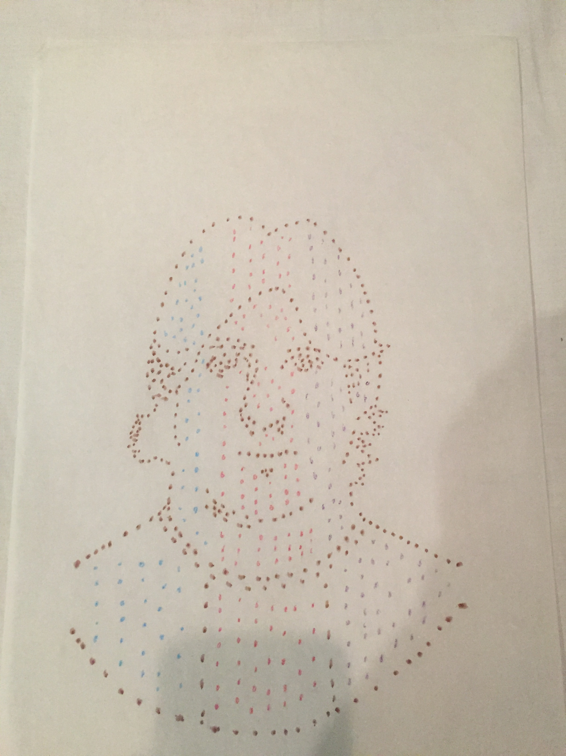
Sketch
In this drawing sketch we can see how I want to make my same drawing I have of Messi, but with a combination of the technique of the screws and the technique of Pete Manson, in which with the images I selected I make a final drawing in which I can show my memories and at the same time the same picture of Messi.

